Slide 1
Interactive Machine Learning Interface
Lilong Jiang

Slide 2
Motivation
Parameter Tuning
Metrics: Euclidean, Cosine, etc.
K-means: number of clusters, how to initialize
Make machine learning more usable
Non-experts
Verify Results
Overfitting, underfitting, etc.
Result is usually not deterministic: clustering, etc.

Slide 3
Works
Architecture: Python + javascript
K-means: initialize centers, change number of clusters
Linear Regression: adjust linear regression on-line
SVM: try different kernels, features

Slide 4
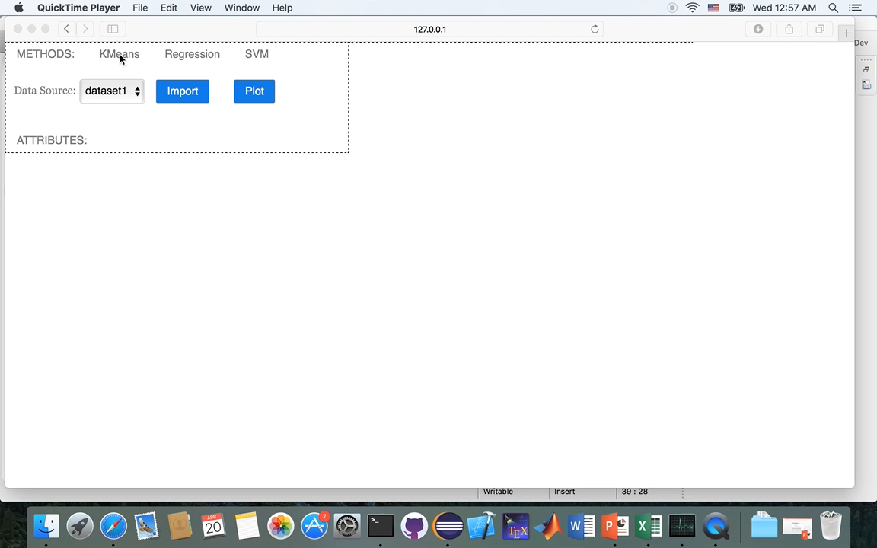
Demo

